Slide 1
Posture recognition using body location sensors
An approach to independent living for elderly

Slide 2
Objective of the study
Findings of the study
Classification of the body posture based on the location of body sensors
The primary concern for the independent living of elderly people is to provide the immediate medical support in case of emergency like falling or fainting
Machine learning algorithms like Decision Trees, KNN, SVM, AdaBoost and XGBoost have identified the activity of person with 88% accuracy.
The best F1-score for classifying the emergency situation of falling is 0.64.

Slide 3
body sensors
Sensors have been placed at 4 locations on body
Chest
Belt
Left Ankle
Right Ankle
Each Sensor record the position
x
y
z

Slide 4
Activities
Each instance of sensor recorded is classified into the activity. There are eleven classification of activities
walking
falling
lying down
lying
sitting down
sitting
standing up from lying
on all fours
sitting on the ground
standing up from sitting
standing up from sitting on the ground

Slide 5
Attributes for machine learning
Three types of attributes have been created for training of ML algorithms
Reference Attributes – Features with a Reference Origin
z coordinate, absolute velocity, velocity in z direction etc. – 24 nos.
Body Attributes – Features considering position of Belt as Origin
x, y, z coordinate, absolute velocity, angles of movement etc. – 24 nos.
Angle Attributes – Angle between upper torso and lower torso
Angle between left ankle and upper torso and right ankle and upper torso – 2 nos.
z
z
y
y
x
x

Slide 6
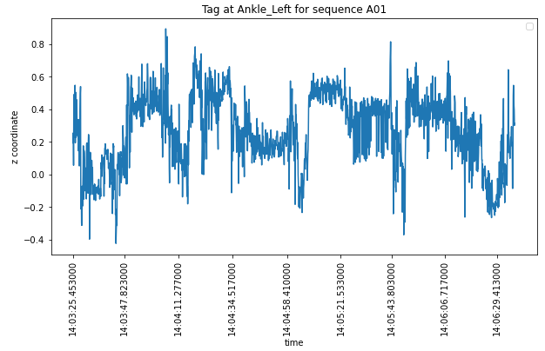
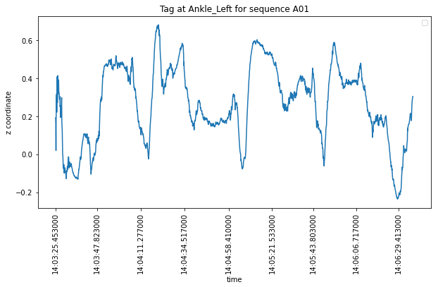
Noise Processing
Noises in the sensors are processed by Kalman Filter Algorithms
Kalman Filter
ML algorithms are trained on both noisy and clean data

Slide 7
machine learning Algorithms
Five Machine Learning Algorithms with hyper meter tuning are trained for classifying the activities
Decision Trees
K-Nearest Neighbor
Support Vector Machine
AdaBoost
XGBoost
Ten Fold Cross Validation with Grid Search is used for hyper parameter tuning.
Recall and F1 score for fall class is used as metrics for identifying best algorithm.

Slide 8
Training Accuracy

Slide 9
Test Accuracy

Slide 10
Precision for Falling

Slide 11
Recall for Falling

Slide 12
F1-Score for Falling

Slide 13
Recommendation
Best Algorithm considered for fall detection is AdaBoost based on F1-score of Falling Class.

Slide 14
THANK YOU

